Slide 2
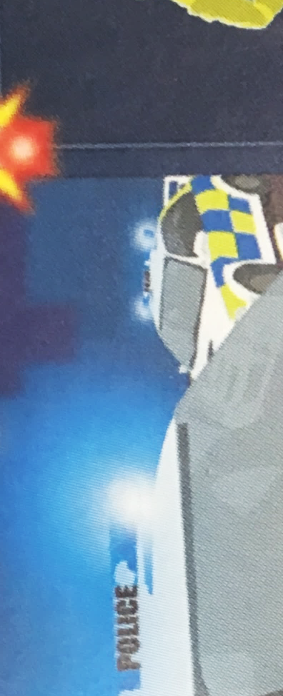
A
What has happened?
Why is the policeman running into the building?
Have you ever seen a crime take place?

Slide 3
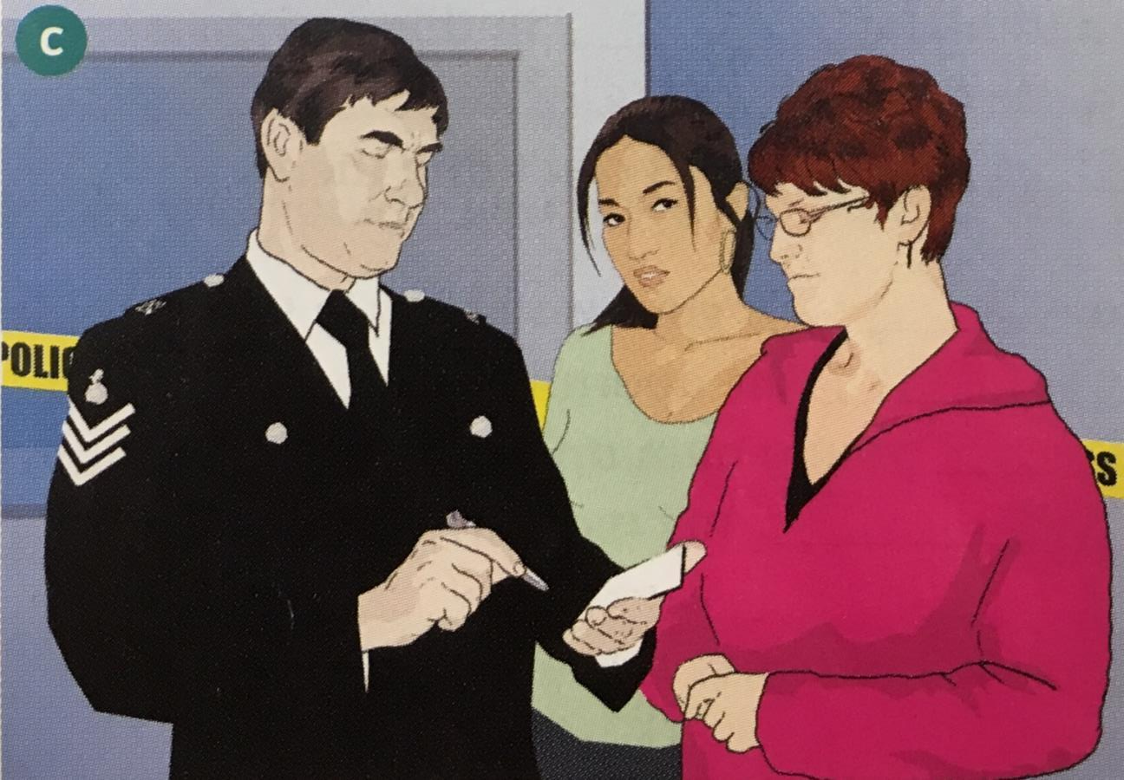
B
Answer these questions with your partner…
What do you think she is telling him?
Why is the policeman talking to the young woman?

Slide 4
Answer these questions with your partner…

Slide 5
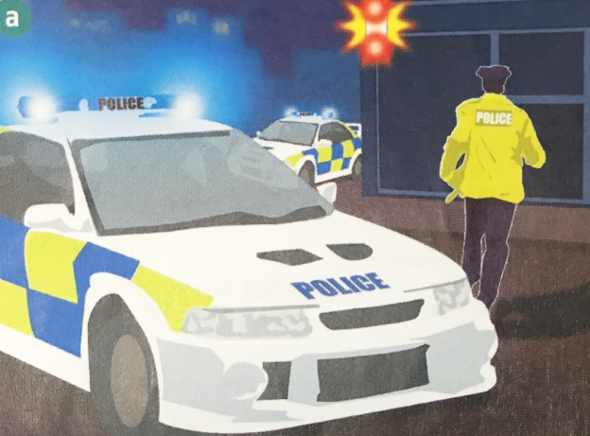
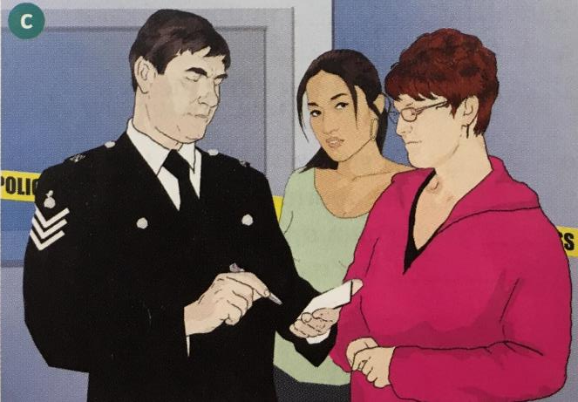
A
B
What has happened?
Why is the policeman running into the building?
Why was the policeman talking to the woman?
What do you think she is telling him?

Slide 6
Here are some words to help us understand what is going on.
Fill in the blanks using the available words only once.
Suspects Robbery Thief Goatee Witness
The _______ took place in the afternoon.
The _______ saw the man in the elevator.
The _______ stole diamonds from the apartment.
The police are looking for the ______.
The man had a _______ on his face.

Slide 7
Fill in the blanks using the available words.
Suspects Robbery Thief Goatee Witness
The _______ took place in the afternoon.
The _______ saw the man in the elevator.
The _______ stole diamonds from the apartment.
The police are looking for _______.
The man had a _______ on his face.
robbery
witness
thief
suspects
goatee

Slide 8
A
B

Slide 9
Useful Language
A.
How (old/young) was he?
What was his/her (hair/mouth) like?
What color were/was his/her (eyes/hair)?
Was his hair (shorter/longer) than mine?
Did he have (glasses / a beard/ a moustache)?
What was he/she wearing?
B.
He was (young / thin, well-dressed).
He/She had (dark hair / a big nose).
His hair was…
He was wearing…

Slide 10
Useful Language
To ask about a person
A.
O
/haʊoʊld/
How old was he?
What was his hair like?
What color were his eyes?
Was his hair shorter than mine?
Did he have glasses?
What was he wearing?
How + descriptive adjective + was + subject?
To describe a person
B.
O
He was young.
He/She had dark hair.
His hair was…
He was wearing…
/hiwəz /
Subject + was + descriptive adjective.

Slide 11
Circle the correct word in the [bracket]:
Questions Answers
How [old/younger] was he? He was [young/wrinkled].
What was his [age/hair] like? His hair was [short/heavy].
What color was her [eyes/hair]? She had [dark/tall] hair.
Was his hair [longer/taller than mine? His hair was [shorter/older] than yours.
Did he have [a beard/well-dressed]? He had a [goatee/blond hair].
What was he/she [wearing/look]? He was wearing [glasses/thin].

Slide 12
A
B

Slide 13
Attention!
Police Announcement!

Slide 14
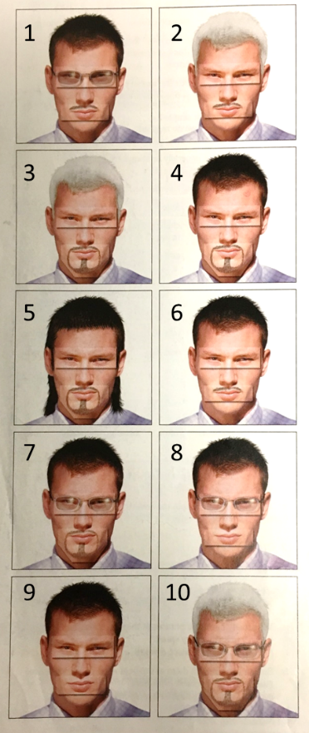
Can you identify the suspect?

Slide 15
Attention!
Police Announcement!

Slide 16
Can you identify the second suspect?

Slide 17
How many police officers chose the correct suspect the first time? The second time?
Did the witness give a good description? Why or why not?

Slide 18
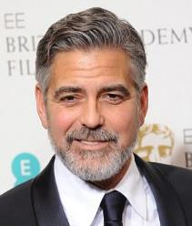
Age: young, middle age, old
Face: smooth, wrinkles, scar
Body shape: thin, medium, heavy
Facial Hair: goatee, side burns, mustache, beard
Hair color: dark, light, blond, brown, black, silver
Hair style: curly, wavy, straight, short, parted, shoulder-length
Eyewear: sunglasses, reading glasses, wire frame
Cloths: shirt, jacket, vest, checkered, plain, casual, formal,
Cliff. M. (2014). Don’t beard it like Bechham if you want to say looking young. Daily Mail. Retrieved from http://www.dailymail.co.uk/femail/article-2811015/DON-T-beard-like-Beckham-want-stay-looking-young-Research-shows-facial-hair-make-man-look-TEN-years-older.html

